Slide 1

Academic learnings from my Internship
Ashwin Cataram Vinod

Slide 2
The Premise
Joined as a Node.JS Developer intern at the DataSmart eServices on January 2014.
The Organization focuses on the growth and development of startup companies.
Helps ingenerating financial interactions with the interested angel investors.
Also provides legal help with services provided by the company’s own accountants and lawyers.

Slide 3
Usage of Databases:
Explained about how relational databases would be worked upon so as to maintain a persistent storage mechanism to store data and optionally implement functionality.
Gained hands-on experience on how to implement the CRUD functionality- Create, Read, Update, and Delete- for the sole purpose to work with the company’s data and update its database, and also mitigate existing entries automatically.
As the part of a group, we had to ensure proper concurrency Control and Transaction Control.

Slide 4
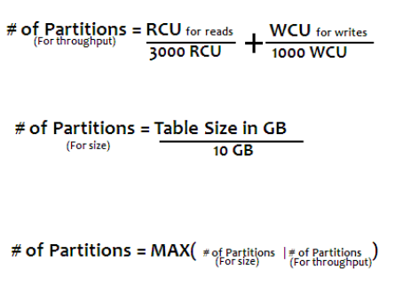
Gained knowledge on how DynamoDB’s working logic:
The reasons for working with DynamoDB was to achieve delivery of performances at any scale, have a durable database with built-in security and to have a backup.
Gained knowledge on implementing MongoDB to perform load balancing in the database and to use the ‘GridFS’.
Created a POC on backend REST API services using Node JS and Mongo.
Configured and monitored numerous MongoDB and NoSQL instances. MongoDB Schema Design using DB Ref, Manual Ref, Embedded Data Model Design.

Slide 5
Web Application Development:
As a team, we were made to develop an online application for making it easy for the clients to find out the status of their project, by letting the end users get all details of how their finances are being invested by just typing in their case number.
If a certain client/startup needed to the status of their legal cases, they could track down their lawyers ongoing procedures.
Developed Single Page Applications (SPS) using Angular route providers and used Angular expressions and built-in directives to render functionality to the UI.
Developed Bootstrap responsive web application pages using Angular services, controllers and directives for front end UI and consumed RESTful web service API.

Slide 6
Developed Web API's for backend data communication.
Worked in using Angular components, Forms, Events, Keys, Router and Animations concept.
Worked on Node JS, with Socket.io to build front-end side with Angular to backend with MongoDB.
Involved to implement various screens for the front end using Angular and used various predefined components from NPM (Node Package Manager).
Gained experience in using various Angular bootstrap directives like modal, popover, tooltip collapse etc.
Used the Quality Center tool to track the defects

Slide 7
Valuable Learnings:
Gained experience in developing applications using Angular.
Hands-on knowledge in AngularJS concepts like Dependency Injection, Promises, Services, Scopes, Controllers and Directives.
Hands on experience working with IDE's like Visual code, Notepad++, Sublime Text.
Gained experience in attending scrum meetings that involved teams from various phases of SDLC.
Learnt Designing using latest Web Standards.
Gained profound knowledge in AngularJS concepts like Dependency Injection, Promises, Services, Scopes, Controllers and Directives.

Slide 8
Thank You
-

